Slide 1
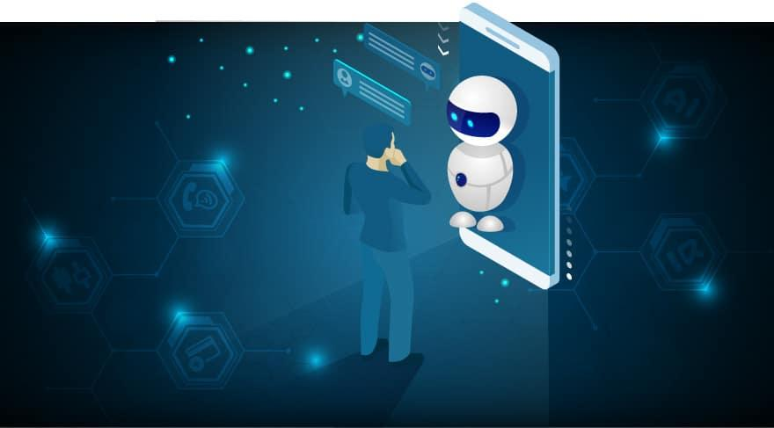
MyDoctor Bot
Project By:
Yashaswi Ghune - 09
Samruddhi Jadhav - 32
Sakshi Jagtap - 36
Punamtanvi Kshatriya - 62
Group No. 32

Slide 2
Project Objective
To provide health assistance on general relevant problems as for the pandemic of covid-19.
Implementation of chatbot integrated with website.
Depending on the symptoms described by the patient the bot will reply with predictions for diseases.

Slide 4
TOOLS and Software Requirements
Technologies Used
Frontend :
HTML
CSS
JavaScript
BootStrap
Backend :
Machine learning
Python
PHP
MySQL
Flask
Jupyter Notebook
XAMPP

Slide 5
Use Case Diagram
Login
Describing Symptoms
Registration
User
Bot
Ask Questions
Predicting Diseases
Describing Symptoms
Providing information about diseaes

Slide 6
Module I
Front End of Website
Backend Of Website

Slide 7
Module II
Chatbot
Integrating chatbot into website

Slide 8
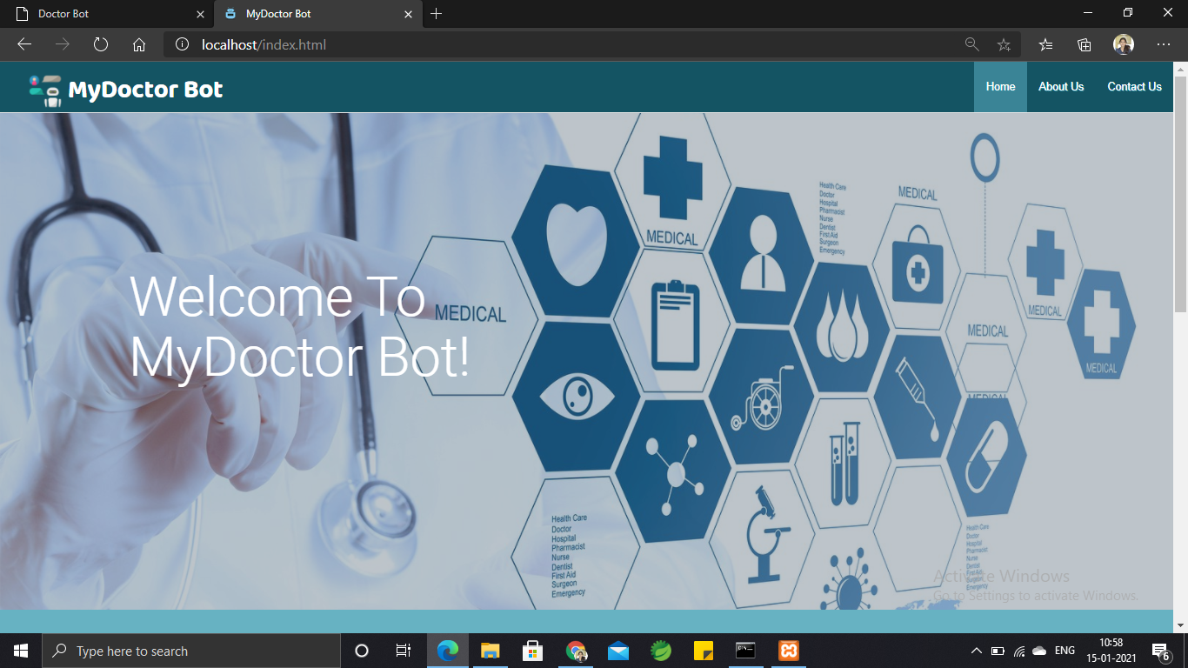
Implementation DEMO

Slide 9

THANK YOU!

